Slide 1
Design and drawing for production
Unit 4 – Alphabet of Lines
Section 1 – Introduction to Alphabet of Lines

Slide 2
Google classroom code
okia9n

Slide 3
QUIZ Review
Average grade was 74.29
Grades ranged from 50 to 100
Only 14 submissions out of 25
No longer accepting submissions for the quiz
Be sure to not miss anymore moving forward

Slide 4
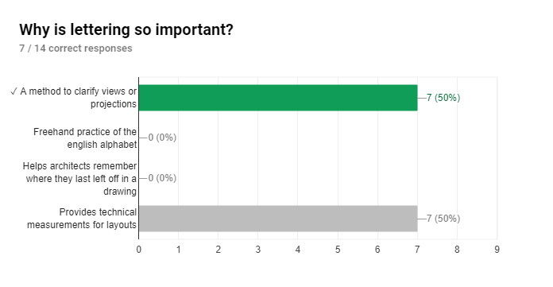

Slide 5
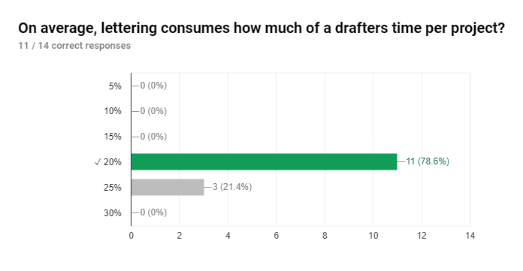

Slide 6
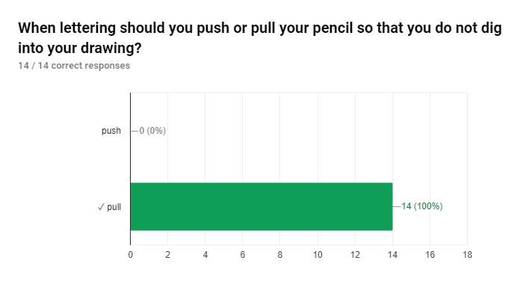

Slide 7
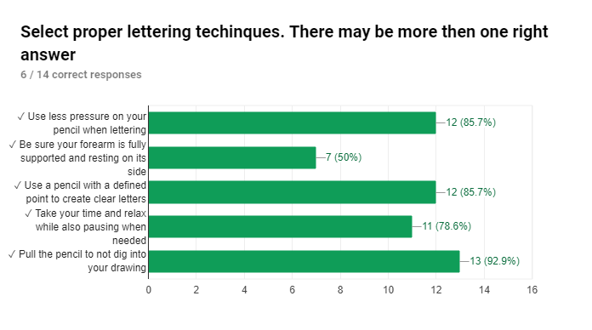

Slide 8
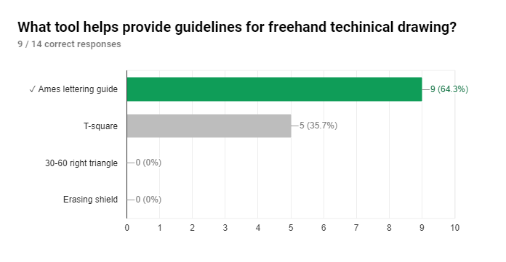

Slide 9
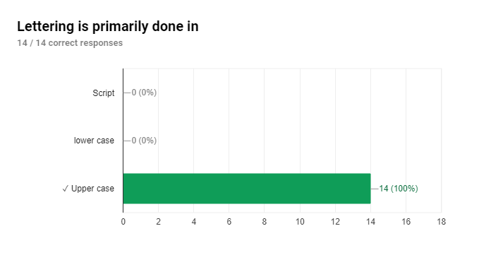

Slide 10
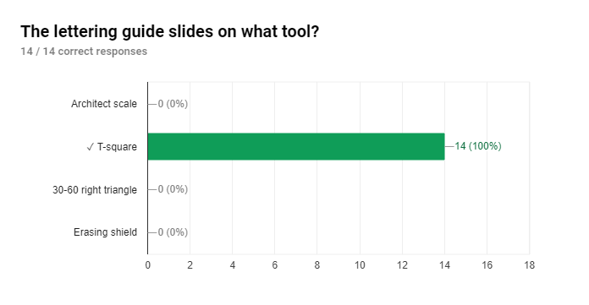

Slide 11
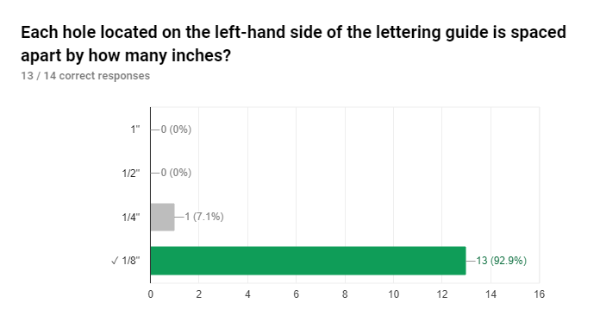

Slide 12
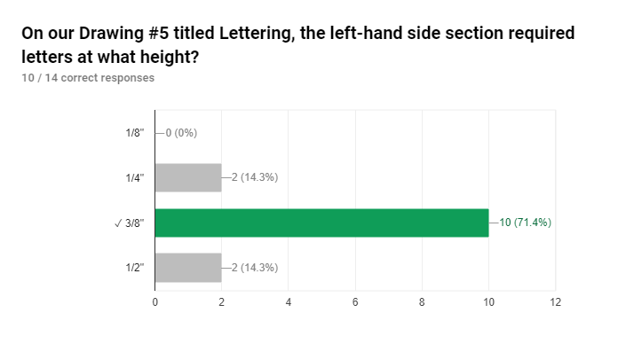

Slide 13
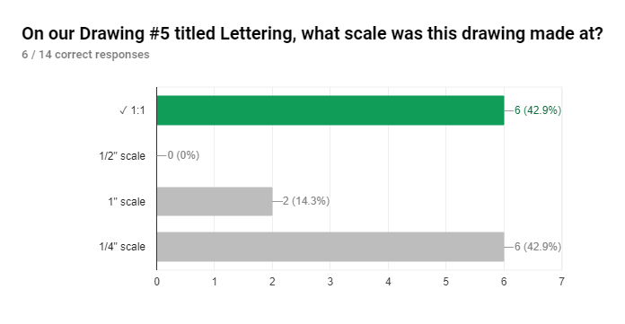

Slide 14
The big idea
There is an industry standard that has been developed for particular line weights with mechanical drawings
ASME stands for American Society of Mechanical Engineers
Alphabet of Lines reveals shape, size, details and alternate part positions
Different width, darkness, and line types are used to communicate a part

Slide 15
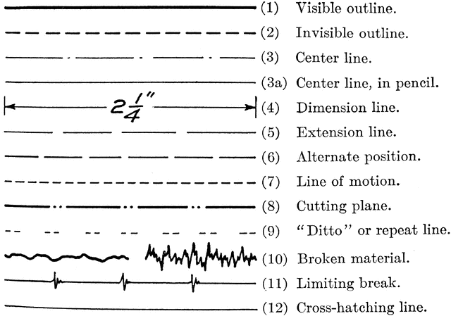

Slide 16
Visible Lines
Most common used line style
Used to outline the visible edges or contours of the object
Should stand our sharply and be easily noticed
They are the darkest lines in the drawing, besides the border

Slide 17
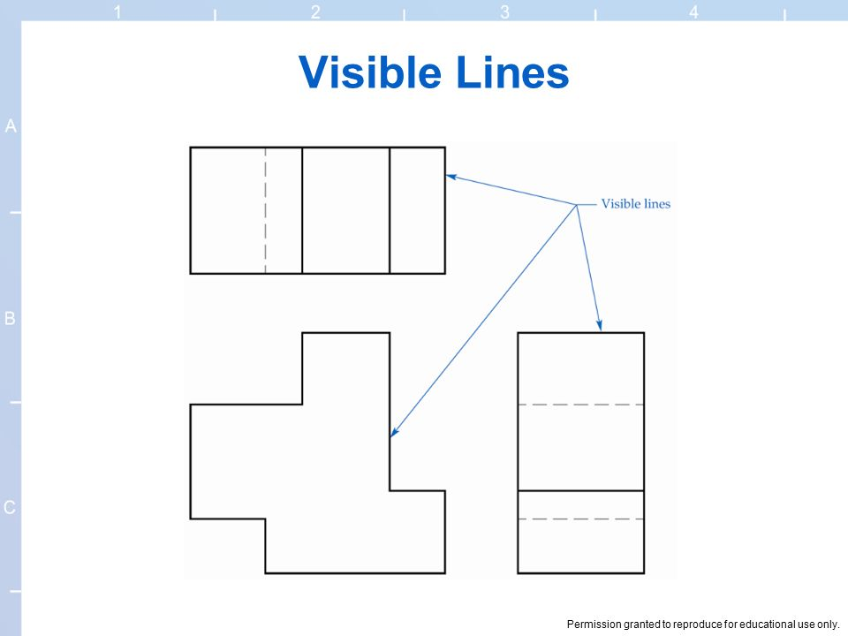

Slide 18
Hidden Lines
Indicate edges that cannot be seen by regular view
Thin or medium lines made up of dashes that are evenly spaced
Each dash is about 1/8” while the spacing between each dash is 1/32”

Slide 19
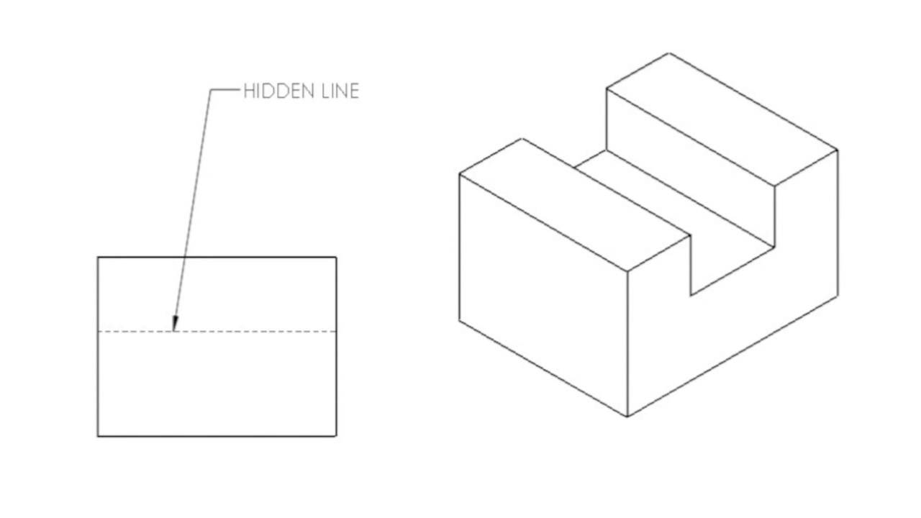

Slide 20
centerlines
Are thin lines composed of long and short dashes alternately spaced with a long dash at each end
Indicate symmetry
Long dashes are followed by spacing and a short dash

Slide 21
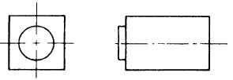

Slide 22
Construction lines
Very light, gray lines
Used to lay out all work
Should be light enough on a drawing so they will not reproduce or be scene as part of the drawing
If you were an arm length away, you should not be able to see construction lines

Slide 23
Border lines
Not part of the standard but are used to frame the drawing
Heaviest darkest of the drawing

Slide 24
LP 2

Slide 25
Alphabet of lines
There is an industry standard that has been developed for particular line weights with mechanical drawings
ASME stands for American Society of Mechanical Engineers
Alphabet of Lines reveals shape, size, details and alternate part positions
Different width, darkness, and line types are used to communicate a part

Slide 26
Alphabet of Lines
Drawing #8

Slide 27
LP 3

Slide 28
Alphabet of Lines
Drawing #8

Slide 29
LP 5

Slide 30
Unit 4 Alphabet of Lines

Slide 31
Google classroom code
okia9n

Slide 32
Drafting neatness
Use your erasing shield as often as possible
Try and wash hands before starting to draw
Always wipe dust and dirt from your instruments
Lay out all views with construction lines then ‘heavy-in’
Remove dust or eraser pieces as soon as possible
Don’t slide instruments, try and lift and put down
Keep an organized orderly drafting area

Slide 33
Alphabet of Lines
Drawing #8

Slide 34
LP 6

Slide 35
Unit 4 Alphabet of Lines

Slide 36
DDP This week
Drawing #8 DUE TODAY!
Every missed day is -10 points
Start drawing #9 Tuesday
Handout
DUE Thursday 10/25
Unit 4 quiz opens up Friday at 9AM
Keep in mind about an 80/20 rule project

Slide 37
LP 9

Slide 38
DDP This week
Drawing #8 DUE MONDAY!
Every missed day is -10 points
Start drawing #9 Tuesday
Handout
DUE TODAY Thursday 10/25
Unit 4 quiz opens up Friday at 9AM
Keep in mind about an 80/20 rule project

